Slide 1
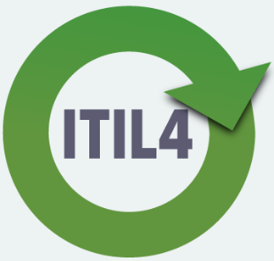
ITILv4
This is an introduction to ITILv4 and covers some of the main components of the framework.
Notes:
The goal of this session is to introduce you to the key concepts and terminology surrounding ITILv4. Many of these definitions carry a sense of common sense but a clear understanding of their meanings will assist you to understand the wider goals and management practices of ITIL.

Slide 2
Introduction
The purpose of ITIL in this course is to:
Introduce you to a IT service management framework
Obtain an understanding of the ITIL language and key ideas
To demonstrate how ITIL can improve IT service management

Slide 3
Who is ITIL relevant to? Why study it?
Anyone working in IT service management such as:
Anyone just starting
Service Agents
Managers
Programmers
IT infrastructure engineers
Database admin
The official ITIL exam:
Closed book
Online
40 MC questions
1 hour
65% pass mark
Why?
If you are intending to provide a service to a user then this is relevant to you.
Notes:
Services don’t just happen on their own. Successful businesses rely on effective IT service management for daily operations. Business who wish to operate well require great service management.

Slide 4
What is ITIL
ITIL stands for: Information Technology Infrastructure Library
“It is a best practice guidance for service management.”
Service management
“A set of specialised capabilities for enabling value for customers in the form of services.”
Axelos, 2019, p. 6, 195

Slide 5
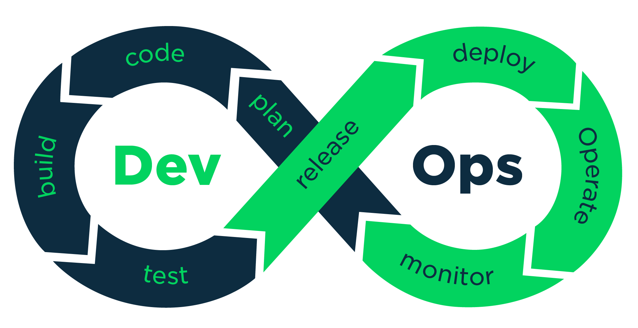
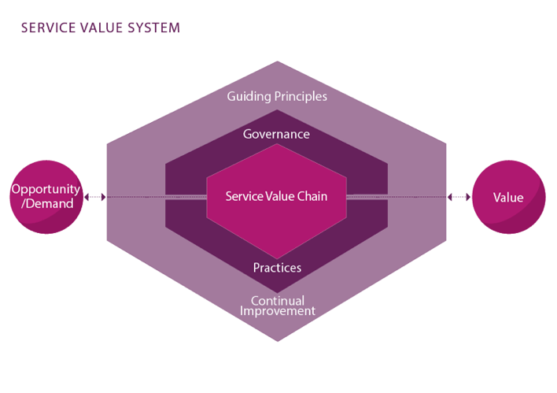
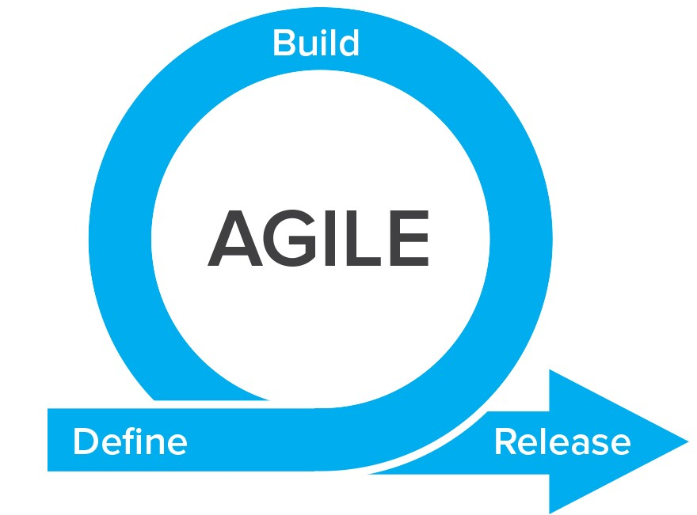

ITIL structure
The first key of ITIL is:
The ITIL service value chain (SVS)
Axelos, 2019, p.3
Notes:
The ITIL 4 framework has two key components. These are; • the ITIL service value system (or SVS) and • the four dimensions model.
The service value system SVS contains a number of core components. The SVS shows how an organisation works together to facilitate value through IT-enabled services. It is flexible and can be easily adapted to an organisation, and includes allowances for approaches such as DevOps and Agile. We will cover a number of these components in this course.
The ITIL service value chain is supported by the other components. The practices support the service chain activities that result in value. The decision and actions of an organisation can be guided by the guiding principles, and creates the culture. The ITIL SVS also includes governance activities to support the organisation’s strategic direction. Every component of the SVS is supported by continual improvement.
First we will briefly look at the service value chain.

Slide 6
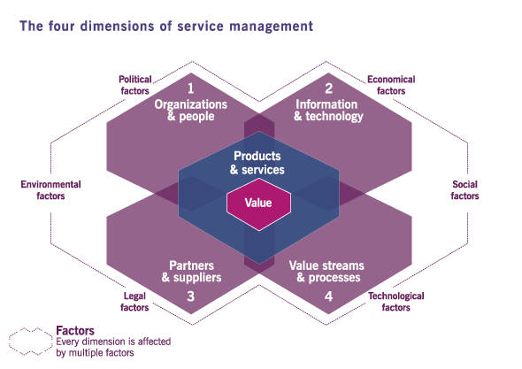
ITIL structure
The second key of ITIL is:
The four dimensions model
Axelos, 2019, p.3
Notes:
The 4 dimensions of service management ensures a holistic approach to service management. You can think of the dimensions as an organisations resources and skills needed to provide its services. For example: think of each of the 4 dimensions of a supermarket. One dimension is it’s partners and suppliers such as farmers, and maybe Fonterra; the IT in the backend that supports its marketing and sales etc; The people who work there; and its systems for storing and displaying the food.
The four dimensions are: • organizations and people • information and technology • partners and suppliers • value streams and processes.

Slide 7
SVS
Input
Output
Axelos, 2019, p.3
Notes:
The first key is the Service Value System SVS. If service management is to work properly it needs to work as a system. The input for this system is the opportunity and demand. The elements for this system are: guiding principles, governance, continual improvement, service management, and the organisations capabilities and resources. The output is the value created for its customers, business and stakeholders.
The system is the collection of parts that work together for a purpose. How do you or will you fit in with the rest of the organisation?

Slide 8
SVS components
SVS component
Guiding principles | Recommendations that guide an organisation in all circumstances, regardless of changes.
Governance | The means by which the organisation is directed.
Service value chain | The activities done to create products and services.
Practices | The organisational practices for daily work and operation.
Continual improvement | An activity performed at all levels to ensure quality performance.
“The ITIL SVS describes how all the components and activities work together as a system to enable value creation.
Axelos, 2019, p.36-37
Notes:
The SVS ensures that the organisation co-creates value with all stakeholders through the use of management and services. As you can see the SVS is not a system to be feared or out there to control the business. It is not fixed but rather it is flexible and adaptive. The system can work in a multiple of different ways according to the needs of the organisation and its stakeholders. It supports many work approaches such as Agile, DevOps and Lean as well as traditional process and project management.
It is important that we understand how our work impacts others and that the organisation is a collection of parts that work together for a purpose.

Slide 9
Opportunity and demand
“Opportunity and demand trigger activities within the ITIL SVS, and these activities can lead to the creation of value.”
The organisation does not always take on all the opportunities.
Demand often drives value.
Axelos, 2019, p.38
Notes:
The key inputs to the SVS are opportunity and demand. Opportunities represent options or possibilities to add value for stakeholders or otherwise improve the organization. For example, an IT service provider may approach a large retail company and offer to provide a set of cloud services. Demand is the need or desire for products and services among internal and external consumers. For example, you might approach your local internet service provider to request a broadband connection that you saw advertised on the TV. And the outcome of the SVS is value, that is, the perceived benefits, usefulness and importance of something. The ITIL SVS can enable the creation of many different types of value for a wide group of stakeholders. For example, if you purchase the broadband package from your local internet service provider, you will receive value in terms of having access to the Internet to send email and watch youtube. i.e. if you are going to create a product or service then you must first consider what demand there is for that product or service.

Slide 10
ITIL guiding principles
Definition:
Recommendations that guide an organisation in all circumstances, regardless of changes.
Focus on value
Keep it simple and practical
Progress iteratively with feedback
Start where you are
Collaborate and promote visibility
Think and work holistically
Optimize and automate
Acrostic: SOFT KIC
Axelos, 2019, p.43
Notes:
You will need to research these as part of an activity in you work books. A guiding principle is universal and enduring. This means they are universally applicable to nearly any initiative and to relationships with all stakeholder groups. Principles are often common-sense things that are taken for granted. For example, imagine if you were cooking a meal. The recipe would tell you the list of ingredients and the cooking method. However, it is unlikely to tell us things such as; wash the utensils after use, hold the knife so you don’t injure yourself and so on. These are things that are learnt with practice. This is the same with the ITIL guiding principles. They have been learnt with practice and are now being passed on through the ITIL guidance.
The ITIL guiding principles create the foundation for an organization’s culture and behaviour from strategic decision-making to day-to-day operations.
One thing you will note is that all of these principles are described in the context of improving what you do. The assumption is that you are trying to improve the way you provide value to stakeholders in the form of products and services. These guiding principles provide a great foundation for such an improvement initiative.

Slide 11
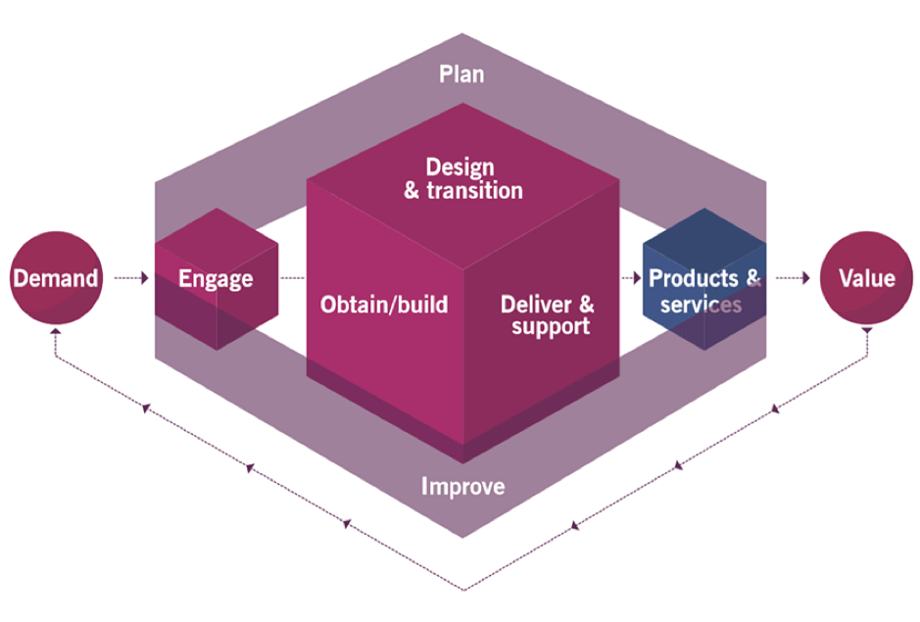
Service value chain
“An operating model which outlines a set of interconnected key activities required to respond to demand and facilitate value realisation through the creation and management of products and services
Axelos, 2019, p.58
Notes:
The service value chain is at the heart of the service value system. Put simply it represents the activities carried out by an organization to create and deliver services. It is a flexible model that defines six key activities that can be combined in many ways to form multiple value streams.
These six value chain activities are:
• plan
• improve
• engage
• design and transition
• obtain/build and
• deliver and support.
These activities represent the steps an organization takes in the creation of value. Each activity contributes to the value chain by transforming specific inputs into outputs. These inputs could be demand from outside the value chain, or they could be outputs of other activities. In this way the activities are connected to, and interact with one another, with each activity receiving and providing triggers for further actions to be taken.

Slide 12
Service value chain
Value streams are defined as “a series of steps an organization undertakes to create and deliver products and services to consumers”
Practices
Supplier management
Service desk management
Relationship management
Service request management
Service value chain rules:
All incoming and outgoing interactions with parties external to the value chain are performed via engage
All new resources are obtained through obtain/build
Planning at all levels is performed via plan
Improvements at all levels are initiated and managed via improve
Axelos, 2019, p.58-59
Notes:
The service value chain converts inputs into outputs through various ITIL practices. Practices are defined as sets of resources designed for performing certain types of work.
Each activity may use internal or third party resources, processes, skills and competencies from one or more practices. For example, the engage value chain activity might draw upon a number of practices including supplier management, service desk management, relationship management and service request management to respond to new demands for products and services, decisions, or information from various stakeholders. To carry out a certain task, or respond to a particular situation, organizations create service value streams. Value streams are defined as “a series of steps an organization undertakes to create and deliver products and services to consumers”. They use specific combinations of activities and practices, and each one is designed for a particular scenario.
A value stream might, for example, be created for a situation where a user of a service needs an incident to be resolved. The value stream will be designed to resolve this, and will provide a complete guide to the activities, practices, and roles involved. Refer to appendix A in the ITIL v4 Foundation book for more detailed examples of value streams.

Slide 13

Service value chain
Value streams
“The ways an organisation creates and delivers products and services”
Design; Manufacture; Distribute; Sell;
Activity 1
Activity 2
Activity 3
Activities
Input
Output
Processes
Notes:
The value streams are the ways an organization creates and delivers products and services. Value streams here would refer to the various activities that are required to design, manufacture, distribute and sell TVs. The same is true for IT service management. Each value stream creates or delivers a product or service that provides value for service consumers. A value stream is similar to an end-to-end process that starts with an event and ends with an outcome for a stakeholder. These value streams transcend functional boundaries to ensure that work is performed and coordinated with value in mind. This example is repeated on the screen now. Take a moment to review it before moving on.

Slide 14
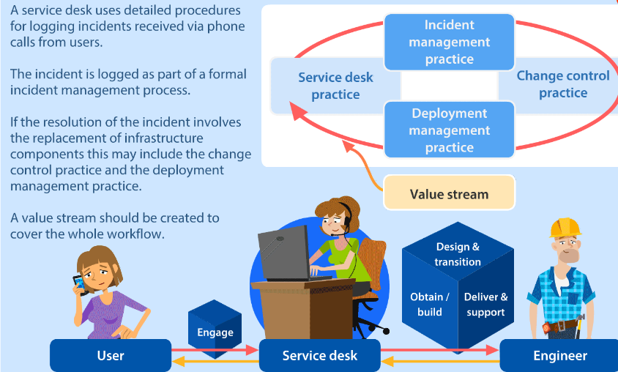
Notes:
The example above shows the value stream process of a service desk dealing with an incident from a user.

Slide 15
Service value chain: Plan
Purpose of PLAN
“To ensure a shared understanding of the vision, current status and improvement direction for all four dimensions and all products and services across the organization.”
It is about planning service management and sharing this plan with stakeholders

Slide 16
Service value chain: Improve
Purpose of IMPROVE
This is about improving products, services and practices across service management
Notes:
The purpose of the improve value chain activity is to ensure continual improvement of products, services and practices across all value chain activities and the four dimensions of service management.

Slide 17
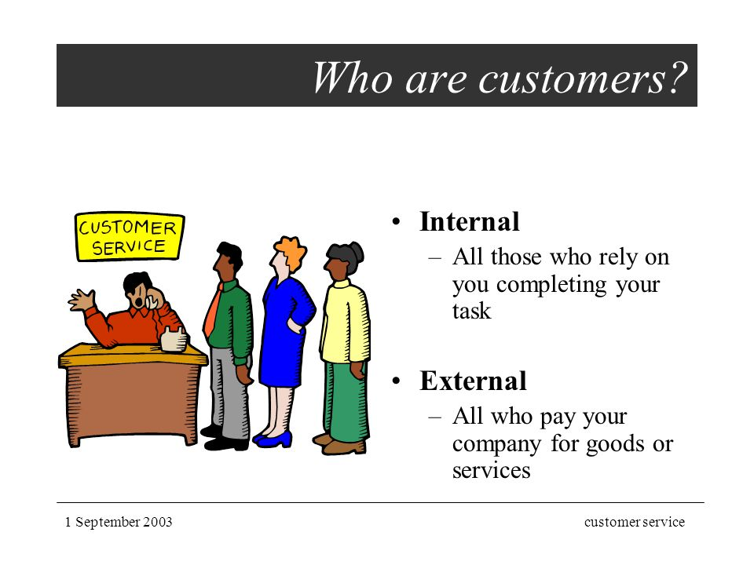
Service value chain: Engage
Purpose of ENGAGE
“To provide a good understanding of stakeholder needs, transparency, and continual engagement and goods relationships with all stakeholders”
Notes:
The third value chain activity is engage.
This activity is on the edge of the model. So any contact with customers must go through this activity.
You must be clear who are customers are as this affects the boundaries of this model. Internal service providers provide service to internal customers. External service providers provide service to external customers.

Slide 18
Service value chain: Design and transition
Purpose of Design and Transition
“To ensure that products and services continually meet stakeholders expectations for quality, costs and time to market.”
Design
Test
Build
Deployment
Notes:
The purpose of the improve value chain activity is to ensure continual improvement of products, services and practices across all value chain activities and the four dimensions of service management.
This part is about creating the products and services according to agreed specifications. Depending upon the methods used in an organization this activity could include the design, build, test and deployment of end-to-end services.

Slide 19
Service value chain: Obtain and build
Purpose of Obtain / Build
“To ensure that service components are available when and where they are needed, and meet agreed specifications”
Notes:
the fifth value chain activity, obtain/build. The main output of the “Obtain/build” value chain activity is components. These components are delivered to the “Design and transition” activity to be built into a service. However the components may sometimes be delivered directly to the “deliver and support” value chain activity.

Slide 20
Service value chain: Deliver and support
Purpose of Deliver and support
“to ensure that services are delivered and supported according to agreed specifications and stakeholders’ expectations.”
Notes:
The final value chain activity is deliver and support. This is where most of the operations work is performed to deliver and support the services that are provided to customers. Incident management for instance is a practice that is part of this activity.

Slide 21
ITIL Structure
A holistic approach to service management.
Axelos, 2019, p.25
Notes:
Think of the four dimensions as the resources that organizations need in order to create and provide services. Failing to address all four dimensions properly may result in services becoming undeliverable, or not meeting expectations of quality. The factors outlined around the edge of this model (e.g. political and environmental) are external and can influence an organizations work flow and practices. When all 4 dimensions are not considered then something could be missing from a service. For example, an organization may upgrade their printers or VOIP software but then fail to train staff on how to support it.
One example is say you want to build a computer network for an organization.
Using the four dimensions let’s consider what we need. • Firstly, do you have the equipment necessary i.e. computers, switches, routers, servers, cables and infrastructure etc • Secondly, we have partners and suppliers: The suppliers are the shops where you source your equipment from say PB tech or HP • Thirdly there are organizations and people: This dimension prompts you to ask whether you have the necessary skills and people to build and manage the network or whether you should ask someone to help. You should also ensure you have a building to work from. • And finally there is value streams and processes: This refers to the method or topology and steps necessary to building and managing this network.

Slide 22


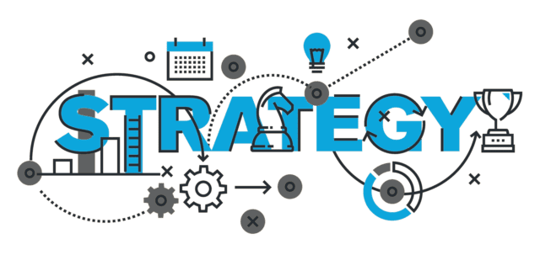
Organisations and people
structure
responsibilities
systems of authority / management
roles
culture
Skills and competencies
Communication and collaboration
Axelos, 2019, p.26
Notes:
Dimension 1: Staff need a culture of trust where they feel safe to make changes and promote new ideas. People in the organization need: structure, roles, responsibilities, communication and systems of authority to properly support the business strategy. Every person needs a clear understanding of how they create value for their organization and stakeholders.

Slide 23
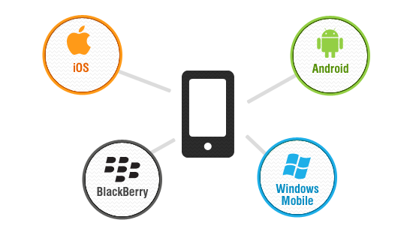

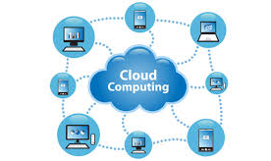
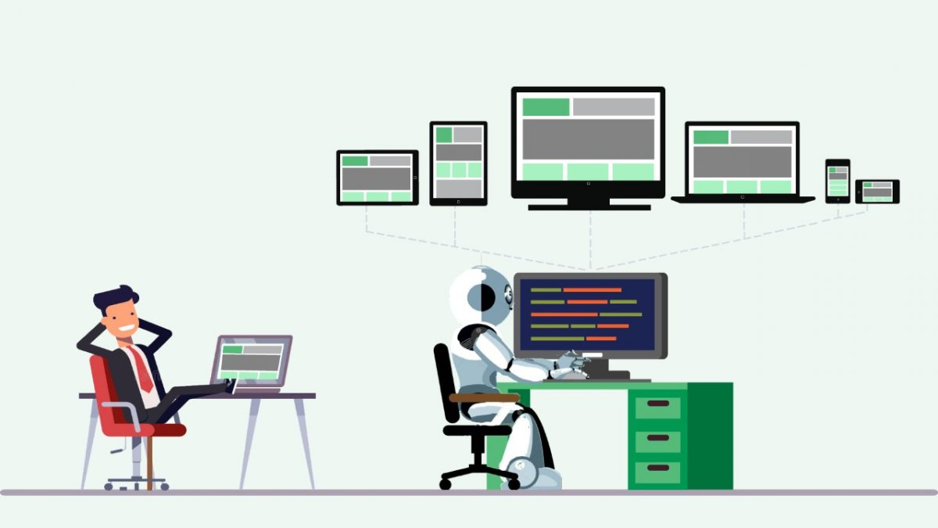
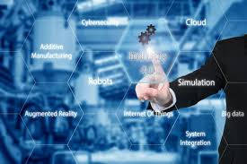
Information and technology
“the information and knowledge necessary for the management of services and technologies required.”
Axelos, 2019, p.27
Notes:
Dimension 2: Information and Technology
This dimension includes the information and knowledge necessary for the management of the services, as well as the technologies required. It also incorporates the relationships between different components of the service value system, such as the inputs and outputs of activities and practices.
Information is at the heart of organizations. No business can operate without the correct information whether it be information about customers, products, employees or information about how to manage the IT services that support the customers and employees.
The use of mobile platforms, cloud solutions, remote collaboration tools, automated testing and deployment solutions has become common practice among service providers.
So, when considering the information component of this dimension, organizations should ask the following questions: • What information is managed by the services? • What supporting information and knowledge is needed to deliver and manage the services? And • How will the information and knowledge assets be protected, managed, archived and disposed of?

Slide 24
Information and technology
Technologies supporting IT services | Technologies supporting service management
Applications | Workflow management systems
IT architecture | Communication systems
Databases | Inventory systems
Artificial intelligence | Mobile platforms
Communication systems | Cloud solutions
Blockchain | Knowledge bases
Cognitive computing | Analytical tools
Cloud computing | Remote collaboration
Mobile applications | Artificial intelligence
 | Machine learning
Axelos, 2019, p.27
Notes:
Technology in service management is typically used in 2 ways. • Firstly, we have the technology that is part of the service. This includes the technology and infrastructure components that the service comprises of, or is supported by. • Secondly, there is the technology that is used by the service provider to help them manage the services. It is also used to automate and optimise processes. In both cases there is a wide range of technology that can be used.

Slide 25
Information technology considerations
Is it compatible with the current architecture? | Does the organisation have the right skills to support and maintain it?
Does it raise any regulatory information, compliance, or information security control issues? | Does it have sufficient automation capabilities to be developed, deployed and operated?
Will it continue to be viable in the foreseeable future? | Does it have additional capabilities that can be leveraged for other products or services?
Does it align with the service provider or service consumer strategy? | Does it introduce new risks or constraints to the organisation?
Notes:
When deciding what technology should be used, both in IT services and IT service management, a lot of things should be taken into account. The culture of the business i.e. whether they want to stay on the cutting edge of technology or whether they would rather be more conservative. Also from a security or secrecy based perspective that certain technologies may not be allowed.

Slide 26
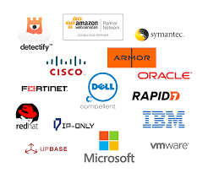

Partners and suppliers
“The partners and suppliers dimension encompasses an organization’s relationships with other organizations that are involved in the design, development, deployment, delivery, support and/or continual improvement of services. It also incorporates contracts and other agreements between the organization and its partners or suppliers.”
Axelos, 2019, p.30
Notes:
The third dimension of service management is partners and suppliers. It is very unlikely that a single organization will provide every part of a service itself. It usually involves other partners or suppliers. For example, managed service providers often acquire access to wide area networks from a telecom supplier then bundle this with other components and services to create products and services for their own consumers. This can mean contracts or agreements between organisations are made.

Slide 27
Partners and suppliers
Form of cooperation | Outputs | Responsibilities for the outputs | Responsibility for the achievement outcomes | Level of formality | Examples
Goods supply | Goods supplied | Supplier | Customer | Formal supply contract / invoices | Procurement of computers and phones
Service delivery | Services delivered | Provider | Customer | Formal agreements and flexible cases | Cloud computing (infrastructure of platform as a service)
Service partnership | Value co-created | Shared between provider and customer | Shared between provider and customer | Shared goals, generic agreements, flexible case-based arrangements | Employee onboarding (shared between HR, facilities and IT
Axelos, 2019, p.30
Notes:
There is no one type of relationship between organizations. The screen shows a table of three types of relationship. You should consider them as three points on a scale. Please bear in mind that these are not definitive, there are many types of relationship that exist between these types.

Slide 28
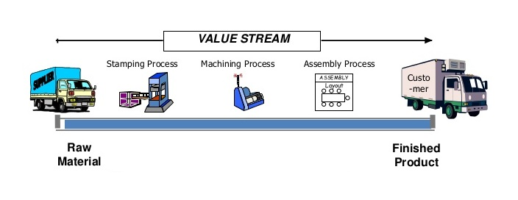
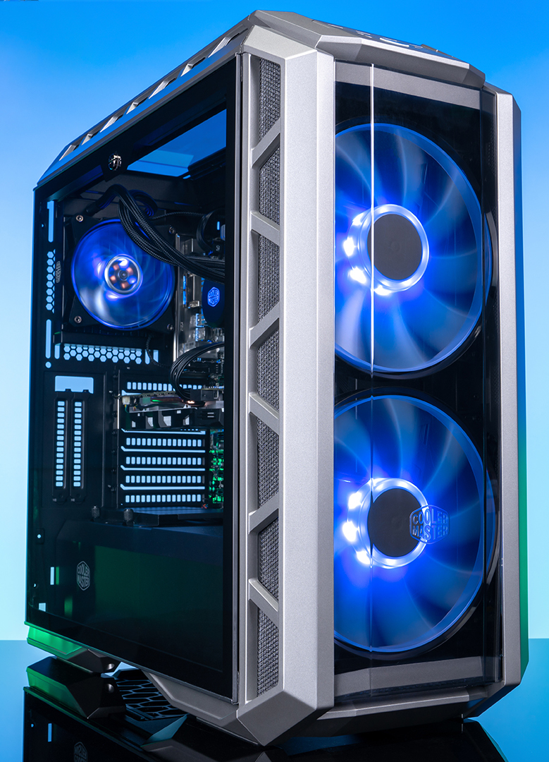
Value streams and processes
“The value streams and processes dimension is concerned with how the various parts of the organization work in an integrated and coordinated way to enable value creation through products and services.”
Value streams and processes focuses on…
The activities the organisation undertakes
How the activities are organised
How the organisation ensures it’s enabling value creation efficiently and effectively
Value stream definition:
“A series of steps an organisation undertakes to create and deliver products and services to consumers.”
Axelos, 2019, p.31-32
Notes:
Dimension 4: Value streams and processes
This dimension defines the activities, workflows, controls and procedures needed to achieve agreed objectives.
'Value' is what the customer gets, like a product or a service of high quality, in a fair period of time at a fair price. The dimension focuses on; • the activities the organization undertakes • how the activities are organized, and • how the organization ensures that it is enabling value creation for all stakeholders efficiently and effectively. ITIL gives organizations acting as service providers an operating model that covers all the key activities required to effectively manage products and services. This is referred to as the ITIL service value chain and is the central part of the service value system. The service value chain operating model is generic, but in practice it can follow different patterns. These patterns within the value chain operation are called value streams.
Value streams are defined as “a series of steps an organization undertakes to create and deliver products and services to consumers”. There is a lot of meaning in this statement. The value streams are the ways an organization creates and delivers products and services. Think about this for a moment. If this was a factory making televisions then the value streams would refer to the various activities that are required to design, manufacture, distribute and sell TVs. The same is true for IT service management. Each value stream creates or delivers a product or service that provides value for service consumers. In fact it is recommended that value streams should be defined by organizations for each of their products and services. A value stream is a bit a like an end-to-end process that starts with an event and ends with an outcome for a stakeholder. These value streams ensure that work is performed and coordinated with value in mind. For example, a user may make a request to their internal IT department for a new work PC. The IT department should map all the activities required to acquire, build, configure and install the PC for the user. This might even include training. This set of activities is the value stream.

Slide 29
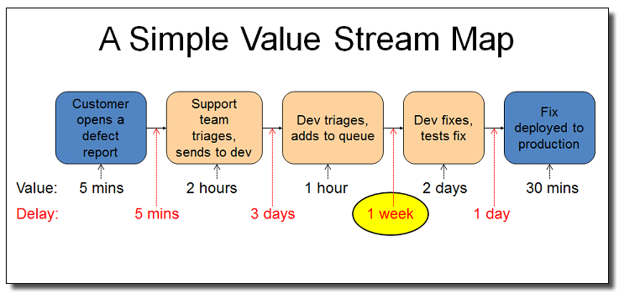
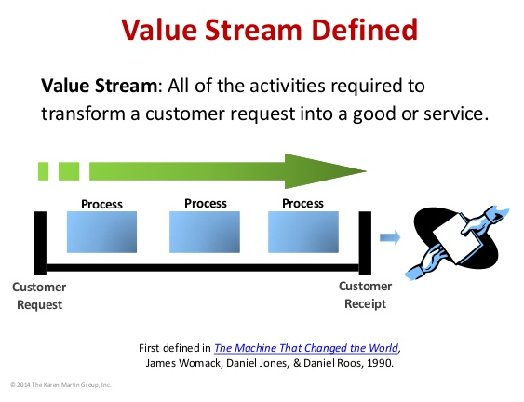
Value streams and processes
“The value streams and processes dimension is concerned with how the various parts of the organization work in an integrated and coordinated way to enable value creation through products and services.”
In LEAN, Value Stream Mapping is a method for analyzing the current state, and designing a future state for the series of events that takes a product or service from its beginning through to the customer. (Dragon1 Website)
Axelos, 2019, p.31-32
Notes:
The diagrams shown above demonstrate some examples of what is meant by value streams.

Slide 30
Key concepts of service management
Value and value co-creation
Organisations, service providers, service consumers, and other stakeholders
Products and services
Service relationships
Value: outcomes, costs and risks
Axelos, 2019, p.6
Notes:
A shared understanding of the key concepts of ITIL is important if we are to try and adapt this framework to ITSM. These concepts apply to all organisations and services, regardless of their nature and underpinning technology.

Slide 31
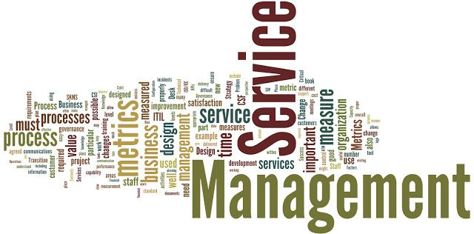
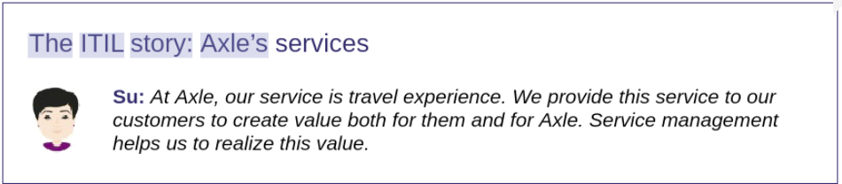
Key concepts of service management
Service management
“A set of specialised organisational capabilities for enabling value for customers in the form of services”
To develop these capabilities we need to understand:
The nature of value
The nature and scope of the stakeholders involved
How value creation is enabled through services
Axelos, 2019, p.6
Notes:
Before we get into the specific concepts we need to cover what service management means

Slide 32
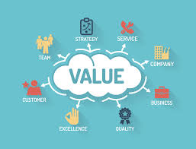
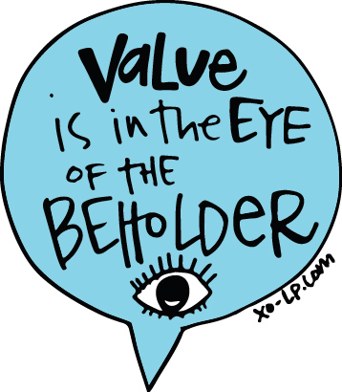
Key concept 1: value and value co-creation
“The purpose of an organisation is to create value for stakeholders.”
Value
the importance, worth, or usefulness of something
Value is often co-created
Axelos, 2019, p.7
Notes:
The purpose of any IT organization is to create value for its stakeholders. So, what do we mean by value? Value is defined as “the perceived benefits, usefulness and importance of something.”
The value of a service or product is often perceived differently among different parties. Customers will generally view their problems with higher priority than other customers and probably rightly so. Value can be subjective.
Value is often co-created between providers, consumers, and possibly other organizations. This means IT departments should seek the feedback and input of their customers not just work in isolation.

Slide 33

Key concept 2: Organisations, service providers, service consumers, and other stakeholders
Organisation:
“A person or a group of people that has its own functions with responsibilities, authorities, and relationships to achieve its objectives.”
Service providers:
An organisation takes on the role of service provider or consumer. The provider may be external or internal to the customer’s organisation.
Customer:
“A person who defines the requirements for a service and takes responsibility for the outcomes of service consumption.”
Service consumer:
When an organisation receives services
Sponsor:
A person who authorises budget for service consumption
User:
A person who uses services.
Organisations vary in size and complexity
Axelos, 2019, p.10
Notes:
Organisations can act as service providers and service consumers. Service consumption may also include: customers, users, and sponsors. The provider can be external to the consumer organization, for example a family buying tickets for a movie in a cinema. The cinema is the service provider and the family is the consumer.
The provider and consumer can both be part of the same organization. In this case the cinema's internal IT department could be the provider, providing IT services to the cinema. For example the software used by the cinema staff to book seats and sell tickets.
It is important in every case that the organization in the provider role has a clear understanding of who its consumers are in a given situation and who the other stakeholders are in the associated service relationships.

Slide 34
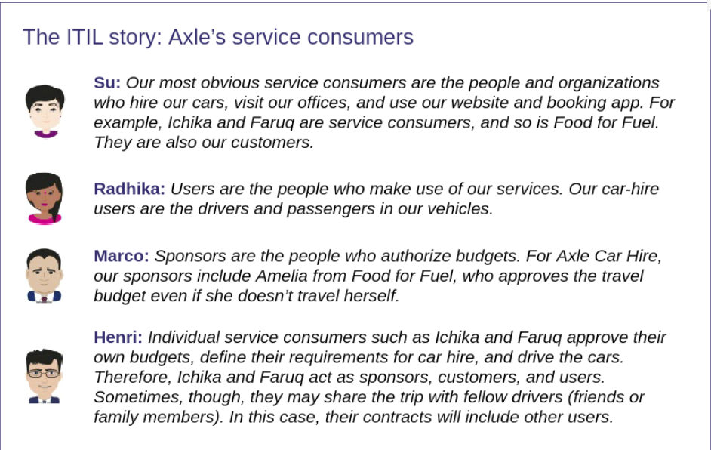
Key concept 2: Organisations, service providers, service consumers, and other stakeholders
Axelos, 2019, p11

Slide 35
Key concept 3: Products and services
Service
“A means of enabling value co-creation by facilitating outcomes that customers want to achieve, without the customer having to manage specific costs and risks.”
Product
“A configuration of an organisation's resources designed to offer value for a consumer”
Axelos, 2019, p.12
Notes:
Two more definitions; service and product. Services that an organization provides are based on one or more products. Services are, of course, central to service management. However, it is common in everyday life to refer to products. This definition states that products are a configuration of an organization’s resources. Resources could refer to people, information and technology, value streams and processes, and suppliers and partners.
Example: a good example is a mobile phone network provider. They provide a mobile phone network connection to a mobile phone used by a customer. The network provider bases the service on a number of products including; the ability to make phone calls, send texts and access the internet.

Slide 36
Service offerings
“Service providers presents their services to consumers as service offerings.”
Service offering
“A formal description of one or more services, designed to address the needs of a target consumer group. A service offering may include goods, access to resources, and service actions.”
Axelos, 2019, p.13
Notes:
A new user of an organisation could be viewed as the service consumer. The IT department may provide the new user with a service offering which could include: goods such as a mobile phone or laptop, access to resources and user support. The consumer takes responsibility for the use of the goods and services under agreed terms and conditions.

Slide 37
Service offering components
Component | Description | Examples
Goods | Supplied to the consumer Ownership is transferred to the consumer | A mobile phone A server
Access to resources | Access is granted or licensed to the consumer under agreed terms and conditions. | Access to network / storage
Service actions | Service and user support Performed in agreement with the user | Tech support
Axelos, 2019, p.14

Slide 38
Key concept 4: Service relationships
Service relationship:
“A cooperation between a service provider and service consumer.”
Service provision:
The act or activity of providing the service e.g. ensuring access to resources or providing the user with a PC.
Service consumption:
The act of consuming services e.g. the user connecting and using the network; also a user requesting tech support. A car rental service receiving the services of a valet company to clean their cars prior to customer use.
Axelos, 2019, p.15
Notes:
A key concept of service management is service relationships. Service relationships is when two or more organisations work together to create something of value (i.e. a product or service).
In a service relationship, organizations will take on the roles of service providers or service consumers. The two roles are not mutually exclusive, and organizations typically both provide and consume a number of services at any given time. Time for a few more definitions. A service relationship is “A co-operation between a service provider and service consumer. Service relationships include service provision, service consumption and service relationship management.”
Service provision is defined as the “Activities performed by an organization to provide services.” Service provision includes: • management of the provider’s resources, configured to deliver the service • access to these resources for users • fulfilment of the agreed service actions and • service level management and continual improvement. Service provision may also include the supplying of goods.
Service consumption includes: • the management of the consumer’s resources needed to use the service • the service use actions performed by users including:
utilizing the provider’s resources
requesting service actions to fulfil.
Service consumption may also include the receiving, or acquiring, of goods.

Slide 39
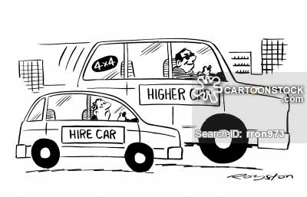
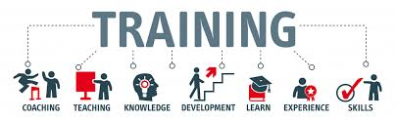

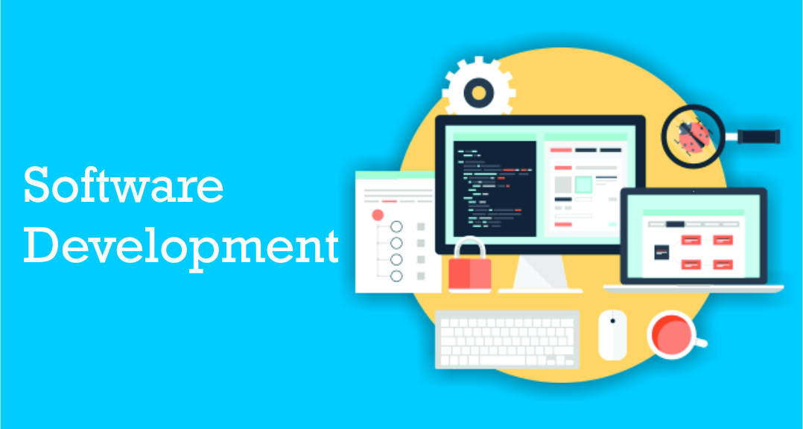
Service relationships
Service relationship management:
Joint activities between the service provider and consumer to ensure the upkeep and continual improvement of service offerings.
Axelos, 2019, p.15
Notes:
Finally, service relationship management is defined as the “Joint activities performed by a service provider and a service consumer to ensure continual value co-creation based on agreed and available service offerings.” When services are delivered by the provider, they create new resources for service consumers, or modify their existing ones. For example; • a training service improves the skills of the consumer’s employees • a broadband service allows the consumer’s computers to communicate • a car hire service enables the consumer’s staff to visit clients and • a software development service creates a new application for the service consumer.

Slide 40
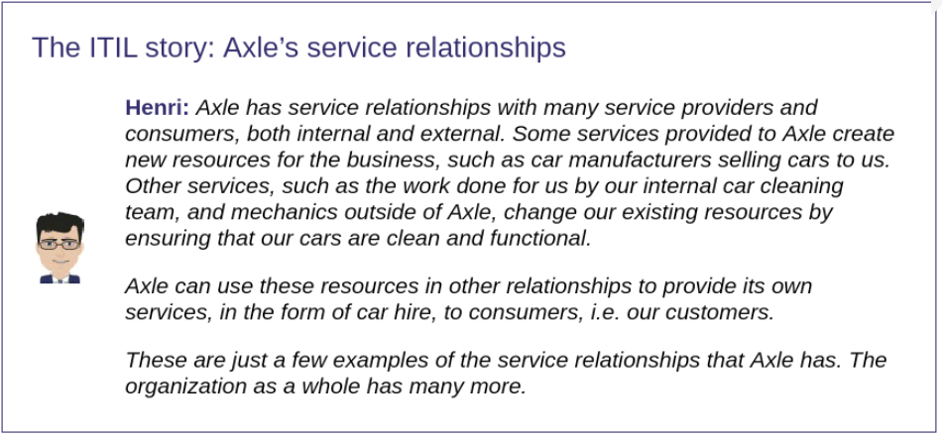
The ITIL story: Axle’s service relationships

Slide 41
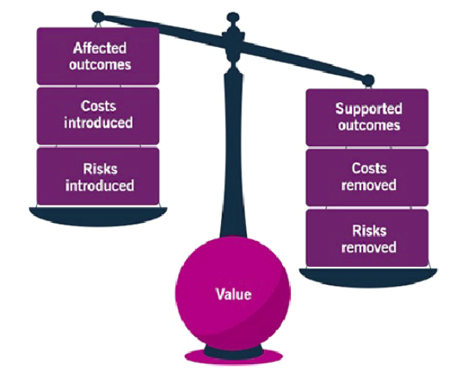
Key concept 5: Value: outcomes, costs, and risks
Output
A tangible or intangible deliverable of an activity
Outcome
A result for a stakeholder enabled by one or ore outputs
Axelos, 2019, p.17
Notes:
So let’s bring all these things together to understand how service providers can ensure that their service will co-create value for service consumers in order to meet the consumer’s needs. Achieving desired outcomes requires resources (and therefore costs) and is often associated with risks. Service providers help their consumers to achieve outcomes, and in doing so, take on some of the associated risks and costs. On the other hand, service relationships can introduce new risks and costs, and in some cases, can negatively affect some of the intended outcomes, while supporting others. Hopefully the positives effects will outweigh the negatives. So what do we mean by outcome and is it any different to output. Here we go with a couple more definitions. An output is defined as “A tangible or intangible deliverable of an activity.” Whereas an outcome is “A result for a stakeholder enabled by one or more outputs.” Example: imagine you have just parked your car in a car park and put some money in the ticket machine. The output of the machine is the ticket. The outcome on the other hand, is the authority to park your car and the peace of mind that it will not be clamped when you return.

Slide 42
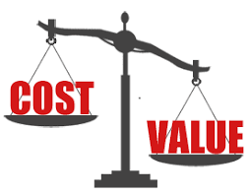
Value: outcomes, costs, and risks
Costs
“The amount of money spent on a specific activity.”
Costs involved in service relationships:
“Costs removed from the consumer by the service” such as staff, technology and resources which is provided by the service provider (not the consumer).
“Costs imposed on the consumer by the service (costs of service consumption)” such as other costs of network utilisation, staff training, resources, etc.
Notes:
From the consumer’s perspective there are two types of cost that we should understand, the costs removed from the consumer by the service and the costs imposed on the consumer by the service. So we have a cost vs value scenario – hopefully the value side outweighs the cost of the service.
Costs are removed from the consumer because the consumer pays for the service for e.g. a customer at a restaurant does not have to worry about the costs of gathering and cooking the food.
However costs can be imposed on the consumer by the service as well for e.g. the cost of the power used to run their PC or technology.

Slide 43
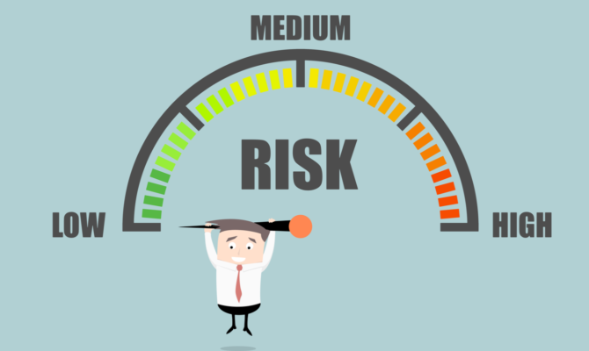
Value: outcomes, costs, and risks
Risks
“A possible event that could cause harm or loss, or make it more difficult to achieve objectives, and or uncertainty of outcome.”
Service consumers are concerned with the risks:
“Risks removed from a consumer (part of the value of the service)”
“Risks imposed on a consumer by the service (risks of service consumption)”
Notes:
Risk can also be defined as uncertainty of outcome, and can be used in the context of measuring the probability of positive outcomes as well as negative outcomes.”
As with costs, there are two types of risk that we should understand, the risks removed from the consumer by the service and the risks imposed on the consumer by the service.
For example the risk removed from the consumer means that the service provider accepts all or some of the risks involved such as hardware failure or lack of network availability or access rights.
Sometimes the consumer needs to accept some responsibility of the service such as a user potentially getting hold of their password or a security breach.
The provider must manage the level of risk on behalf of the user.
Another example is when a family buys a movie ticket and purchases LUX or premier tickets instead of standard tickets. The premier tickets ensure the consumer has comfortable viewing seats and will not go hungry during the movie. On the other hand the consumer has the risk of turning up late to the movie and missing some of it.

Slide 44
Utility and warranty
Utility
“The functionality offered by a product or service to meet a particular need.”
‘What the service does’
Is the service fit for purpose
A service must do what it claims to do i.e. support the performance
Or it must remove the constraints from the consumer
Notes:
E.g. What is the product useful for?
To create value, a service must meet customer expectations in terms of both Utility and Warranty.
“the functionality offered by a product or service to meet a particular need. Utility is about ‘what the service does’ and can be used to determine whether a service is ‘fit for purpose’.
To have utility, a service must either support the performance of the consumer or remove constraints from the consumer. Of course many services do both.”
To evaluate whether or not a service or service offering will facilitate the outcomes desired by the consumers and therefore create value for them, the overall utility and warranty of the service should be assessed.
So in our Movie Cinema example, the basic utility is that the movie will play from start to finish with clarity and volume.

Slide 45
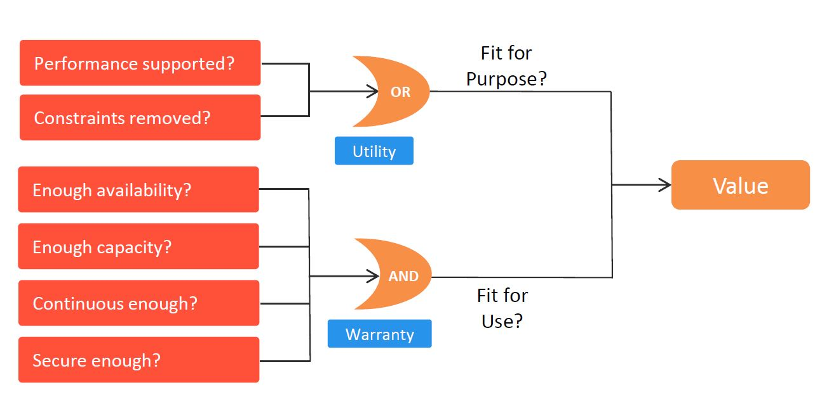
Utility and warranty
Warranty
“assurance that a product or service will meet agreed requirements.”
How the service performs
Often the warranty is documented as part of the service level and agreed upon by consumer and provider
Warranty addresses areas such as the availability of the service, security or capacity.
Notes:
Costs and risks of a service must be measured when considering whether a service offering or service meets the requirements of utility and warranty.
Both utility and warranty is essential for meeting desired outcomes of a product or service i.e. value.
For example, a theme park may have many thrilling rides, but if a number of the rides are frequently unavailable (due to mechanical difficulties) then the park is not fulfilling the warranty and the customers will not receive their expected value.
Also if the rides are up all the time but not offering the full experience promised (such as not as fast or scary) then utility is not fulfilled.

Slide 46

Summary
Introduction to ITILv4
Why you would study it
It's relevance to industry
Definition of ITIL
ITIL Structure
The service value system and components
The 4 dimensions of service management
ITIL guiding principles
Service value chain
Key concepts of service management
Notes:
In this session we have covered:

